Slide 1
Learning Objective
I will review trigonometry ratios and applications
Success Criteria
At the end of the lesson, I will be able to:
Determine the unknown sides and angles using trigonometry ratios

Slide 2
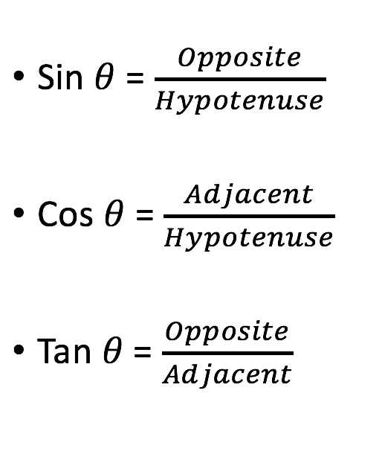
Trigonometric Ratios
Activating Prior Knowledge

Slide 3
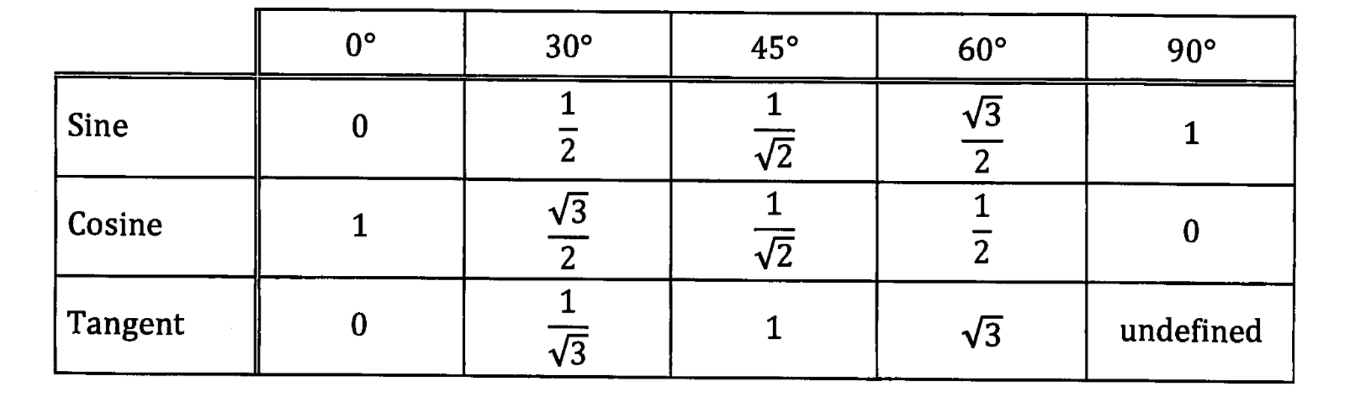
Table of Exact Value
Activating Prior Knowledge

Slide 4






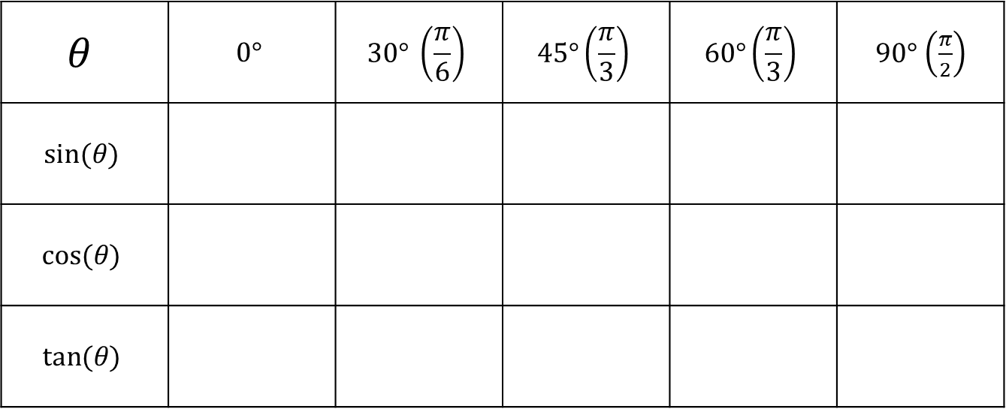












Method 1 – Deriving Exact Value from Table
Step 1: Draw a table, Populate the Table with the angles 0, 30, 45, 60, 90 at the top
Step 2: Populate $\sin\left(θ\right)$ row with values from 0 to 4
Step 3: Square-root the top numbers
Step 4: Divide the top row by 2
Step 5: Evaluate
Step 6: Populate the $cos(θ)$ row by flipping the $\sin\left(θ\right)$ row values
$$θ$$ | $$0°$$ | $$30° \left(\frac{π}{6}\right)$$ | $$45°\left(\frac{π}{3}\right)$$ | $$60°\left(\frac{π}{3}\right)$$ | $90°$ $\left(\frac{π}{2}\right)$
$$sin⁡(θ)$$
$$cos(θ)$$
$$tan⁡(θ)$$
$$\frac{\sqrt{0}}{2}$$
$$\frac{\sqrt{4}}{2}=1$$
$$\frac{\sqrt{0}}{2}=0$$
$$\sqrt{0}$$
$$\frac{\sqrt{1}}{2}=\frac{1}{2}$$
0
1
$$\frac{\sqrt{1}}{2}$$
$$\sqrt{1}$$
2
$$\frac{\sqrt{2}}{2}$$
$$\frac{\sqrt{2}}{2}$$
$$\sqrt{2}$$
3
$$\frac{\sqrt{3}}{2}$$
$$\frac{\sqrt{3}}{2}$$
$$\sqrt{3}$$
4
$$\frac{\sqrt{4}}{2}$$
$$\sqrt{4}$$
$$\frac{\sqrt{4}}{2}=1$$
$$\frac{\sqrt{3}}{2}$$
$$\frac{\sqrt{2}}{2}$$
$$\frac{\sqrt{1}}{2}=\frac{1}{2}$$
$$\frac{\sqrt{0}}{2}=0$$

Slide 5


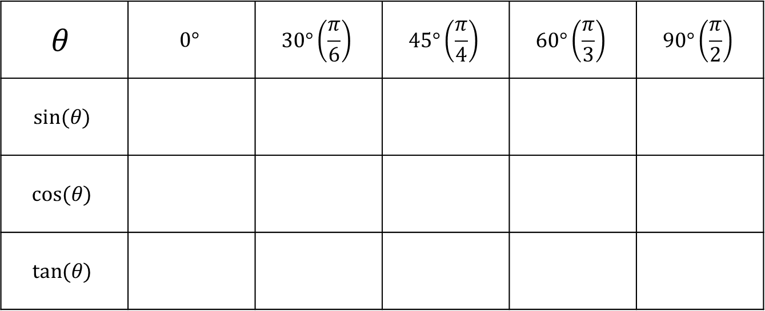





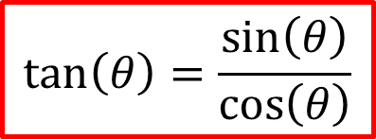
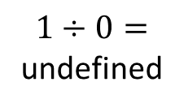










Method 1 – Deriving Exact Value from Table
$$\tan\left(θ\right)=\frac{\sin\left(θ\right)}{\cos\left(θ\right)}$$
You now have populated the $\sin\left(θ\right)$ row and $cos(θ)$ row
Next let’s populate the $\tan\left(θ\right)$
Step 7: Divide $\sin\left(θ\right)$ by $\cos\left(θ\right)$
We now have a complete table!
$$θ$$ | $$0°$$ | $$30°\left(\frac{π}{6}\right)$$ | $$45°\left(\frac{π}{4}\right)$$ | $$60°\left(\frac{π}{3}\right)$$ | $$90°\left(\frac{π}{2}\right)$$
$$sin⁡(θ)$$
$$cos(θ)$$
$$tan⁡(θ)$$
$$0$$
$$\frac{1}{2}$$
$$\frac{\sqrt{2}}{2}$$
$$\frac{\sqrt{3}}{2}$$
$$1$$
$$\frac{\sqrt{3}}{2}$$
$$\frac{\sqrt{2}}{2}$$
$$\frac{1}{2}$$
$$1$$
$$0$$
$$\frac{1}{2}÷\frac{\sqrt{3}}{2}$$
$$\frac{\sqrt{2}}{2}÷\frac{\sqrt{2}}{2}$$
$$\frac{\sqrt{3}}{2}÷\frac{1}{2}$$
$$1÷0=$$
undefined
$$\frac{1}{2}×\frac{2}{\sqrt{3}}=\frac{1}{\sqrt{3}}$$
$$\frac{\sqrt{2}}{2}×\frac{2}{\sqrt{2}}=1$$
$$\frac{\sqrt{3}}{2}×\frac{2}{1}=\sqrt{3}$$
$$0÷1=0$$

Slide 6
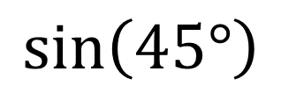
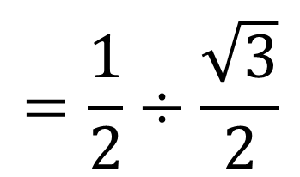
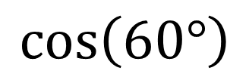
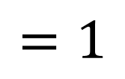
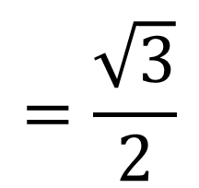
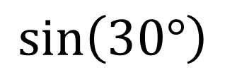
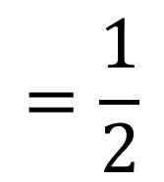
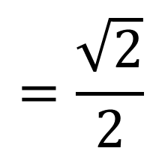
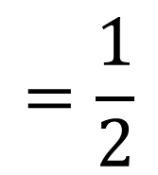
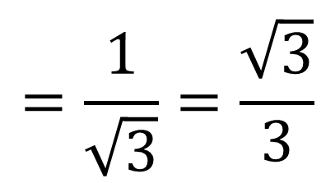
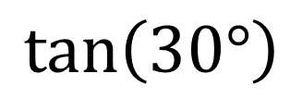
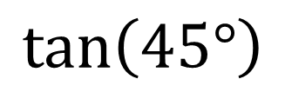
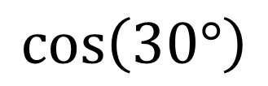
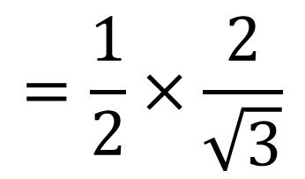
Guided Practice
$$=\frac{\sqrt{2}}{2}$$
$$=\frac{1}{2}$$
$$\sin\left(45°\right)$$
$$\sin\left(30°\right)$$
$$=\frac{\sqrt{3}}{2}$$
$$=\frac{1}{2}$$
$$\cos\left(30°\right)$$
$$\cos\left(60°\right)$$
$$=\frac{1}{2}÷\frac{\sqrt{3}}{2}$$
$$\tan\left(30°\right)$$
$$\tan\left(45°\right)$$
$$=1$$
$$=\frac{1}{\sqrt{3}}=\frac{\sqrt{3}}{3}$$
$$=\frac{1}{2}×\frac{2}{\sqrt{3}}$$

Slide 7








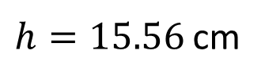

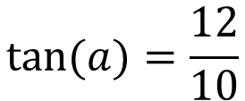
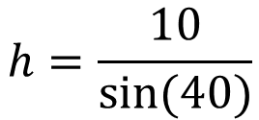

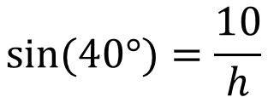

Calculate, to 2 decimal places, the value of the pronumeral shown in each diagram.
Guided Practice
$$12$$
$$h$$
$$10 cm$$
$$x$$
$$8$$
$$a$$
$${40}^{o}$$
$$x^{2}=6^{2}+8^{2}$$
$$\sin{(40°})=\frac{10}{h}$$
$$x=10$$
$$6$$
$$\tan{(a)}=\frac{12}{10}$$
$$h=\frac{10}{\sin{(40)}}$$
$$a=50.19°$$
$h=15.56$ cm

Slide 8


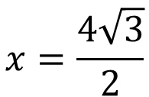


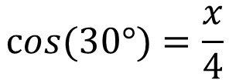

A ladder of length 4 metres leans against a wall. If the ladder is inclined at 30º to the ground, how far is exactly the foot of the ladder from the wall? Leave your answer in exact form.
Calculator Free - Guided Practice
$$\cos{(30°})=\frac{x}{4}$$
$$x=4\cos{(30°)}$$
$$4 m$$
$$x=\frac{4\sqrt{3}}{2}$$
$${30}^{o}$$
$$x=2\sqrt{3}$$
$$x m$$

Slide 9
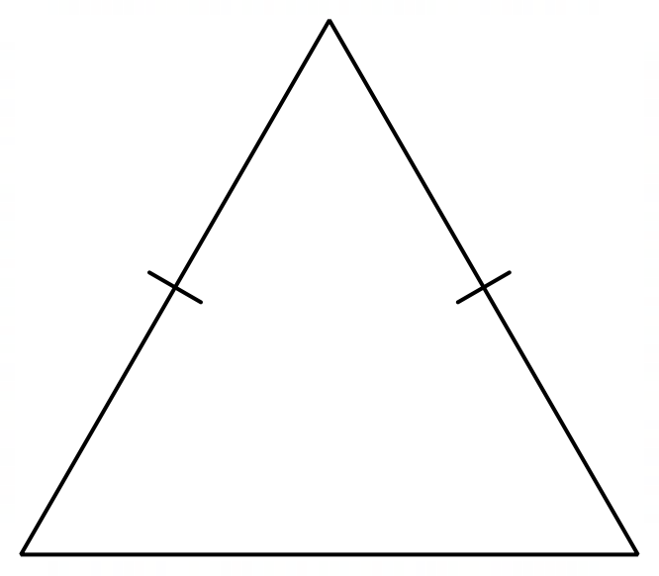


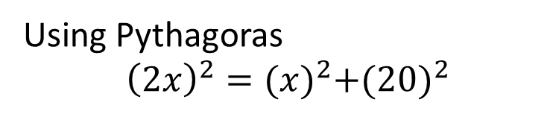


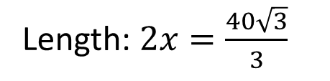




An equilateral triangle has altitudes of length 20 cm. Find the length of one side in exact form.
Calculator Free - Guided Practice
Using Pythagoras
$${\left(2x\right)}^{2}={(x)}^{2}+{(20)}^{2}$$
$$4x^{2}=x^{2}+400$$
$$2x$$
$$2x$$
$$3x^{2}=400$$
$$20m$$
$$x^{2}=\frac{400}{3}$$
$$x=\sqrt{\frac{400}{3}}$$
$$x$$
$$x$$
$$x=\frac{20}{\sqrt{3}}=\frac{20\sqrt{3}}{3}$$
Length: $2x=\frac{40\sqrt{3}}{3}$

Slide 10
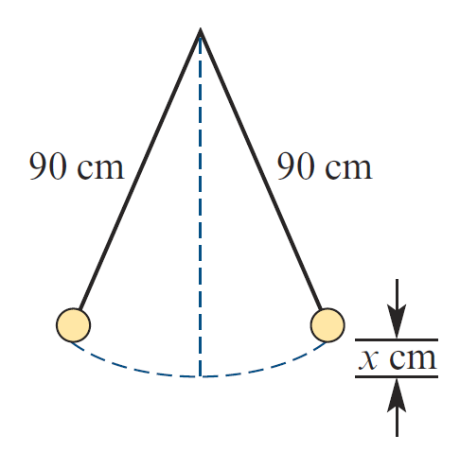


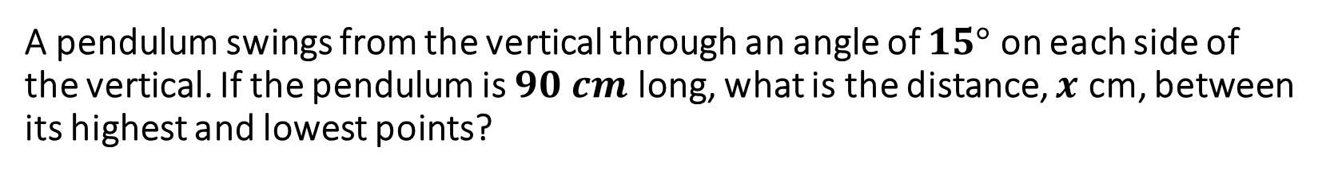




A pendulum swings from the vertical through an angle of $15°$ on each side of the vertical. If the pendulum is $90 cm$ long, what is the distance, $x$ cm, between its highest and lowest points?
Guided Practice
$$\cos{(15)}=\frac{y}{90}$$
$$y=90\cos{(15)}$$
$$y$$
$$90 cm$$
$$x=90−90\cos{(15)}$$
$$x=3.07 cm$$
$$x$$

Slide 11
Independent Practice
Complete Cambridge Ex 13A
Skip Q1

